Slide 1

Social Distancing Indicator
Done By : Srinidhi Kannan (BL.EN.U4AIE21121)
Suryamritha M (BL.EN.U4AIE21126)
Varshini Balaji (BL.EN.U4AIE21139)

Slide 2
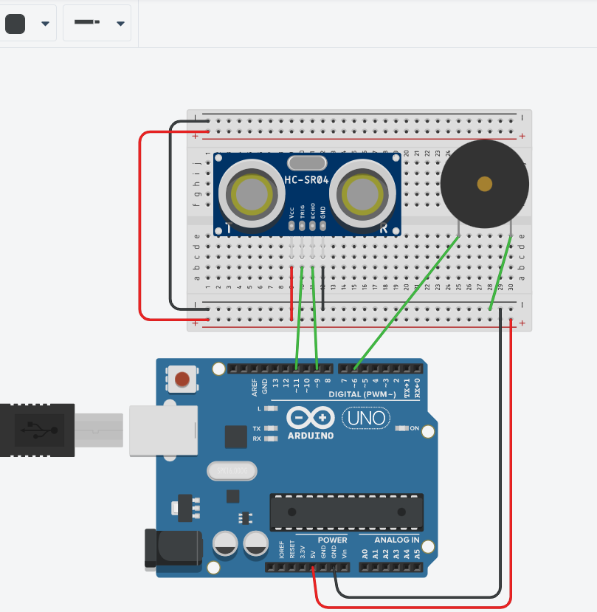
Social Distancing Indicator
Social distance keeper using ultrasonic sensor and buzzer. As we know during this pandemic situation everyone should maintain social distance to fight with corona so this circuit will alert users if they come closer than 200cm and buzzer will ring.

Slide 3
Researches :
Social Distancing using Bluetooth Low Energy.
Social Distancing Detection with Deep Learning Model.
A Smart Social Distancing Monitoring System.

Slide 4
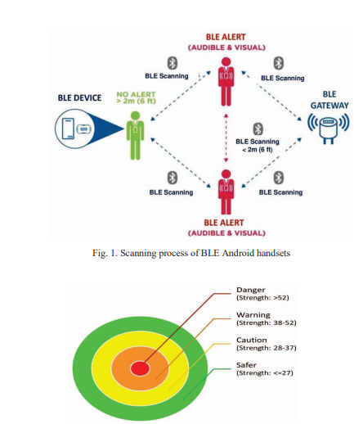
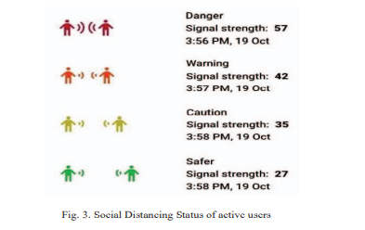
Social Distancing using Bluetooth Low Energy.

Slide 5
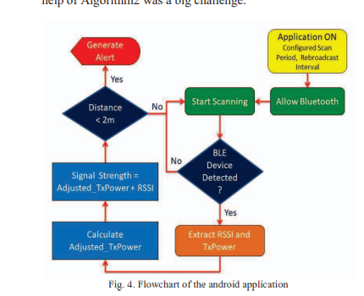

Slide 6
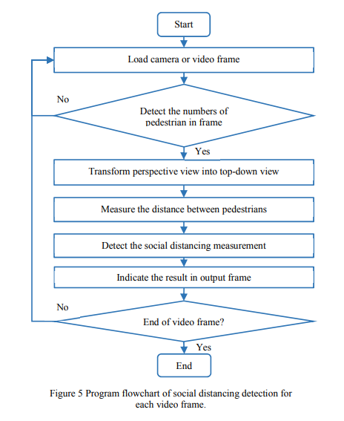
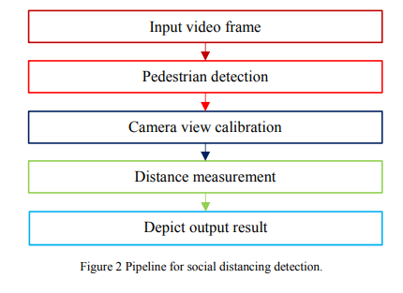
Social Distancing Detection with Deep Learning Model.

Slide 7
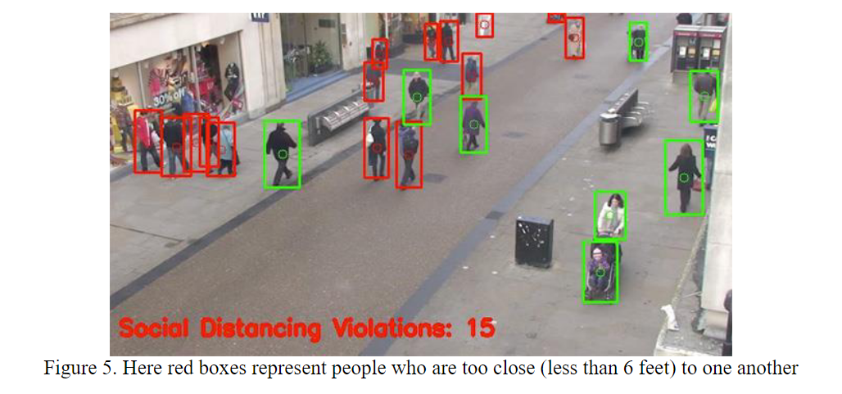

Slide 8
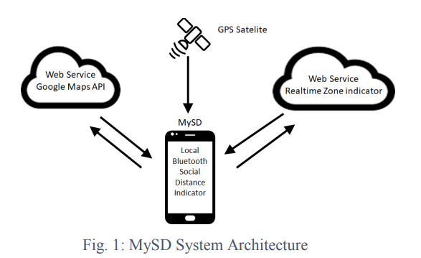
A Smart Social Distancing Monitoring System.

Slide 9
